Slide 1
Technical Interview Workshop
http://bit.ly/techvanguard
February 8th, 2019

Slide 2






Who we are
Jess Tang Software Developer
Rasidha Rahman
Security Project Manager/BSA
Megan Heyer
Software Developer

Slide 3
Stages of an Interview
Apply
Phone Screen
Technical Screen
Onsite Interview

Slide 4
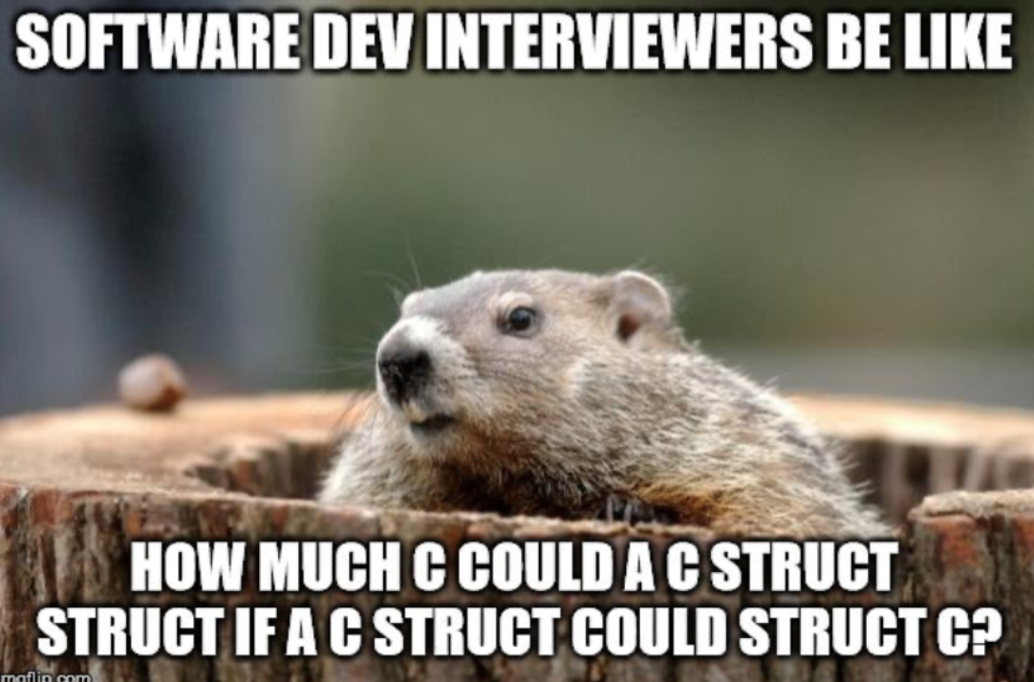
What is a technical interview?
Used to assess technical ability
Many forms of technical interviews (our focus: coding assessment)
Coding assessments
Brain Puzzles
Debugging
System Design

Slide 5
Why is a technical interview important?
Shows how you tackle real-world problems
Interviewers are looking for
Problem-solving skills
Testing code as you write it
Enthusiasm/ Teamwork
Communication skills

Slide 6
WHAT TO DO DURING TECHNICAL INTERVIEW
State which programming language you will use unless told a specific one
Ask clarifying questions before writing code
Speak clearly and precisely
If you’re stuck:
Stay calm
Think out loud
Try new ideas

Slide 7


Technical Interview Approach
Brute Force Solution
Consider edge cases
Optimize solution
Explain implementation

Slide 8


Gold Bar Interview Question
You have one gold bar. For seven days, you must pay your employee with one gold segment each day. Breaking the bar only twice, how can you ensure the employee gets paid appropriately?
* As of June 30, 2018.

Slide 9

Instructions for Activity
Task: Choose a problem to solve in 30 mins
Make some friends!
Split into groups of 2-3
Get out of your comfort zone
Talk out loud
Use scratch paper when possible
Use the approaches we talked about
Feel free to look at solutions when you are finished!
* As of June 30, 2018.

Slide 10
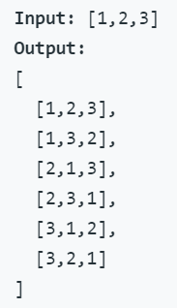

3 Interview Questions
leetcode.com/problems/two-sum/
Given an array of integers, return indices of the two numbers such that they add up to a specific target.
You may assume that each input would have exactly one solution, and you may not use the same element twice.
leetcode.com/problems/valid-palindrome/
Given a string, determine if it is a palindrome, considering only alphanumeric characters and ignoring cases.
Note: For the purpose of this problem, we define empty string as valid palindrome.
https://leetcode.com/problems/permutations/
Given a collection of distinct integers, return all possible permutations.
Example:
Easy
Medium
Hard

Slide 11
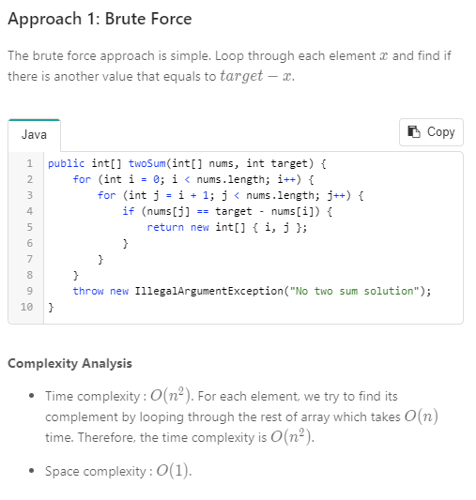

Possible solution
to #1
* As of June 30, 2018.

Slide 12
Common Must Study Topics
Data Structures
Big O Notation
Trees
Sorting and search algorithms
Heaps
Arrays
Hash tables

Slide 13
Advice collected from completing 30+ Interviews
Study!
Focus on one or two programming languages
The interviewer wants you to succeed
Don't be afraid of admitting you're stuck
Slow down, take your time, think it through
Don’t worry about bringing a laptop (unless the interviewers specifically request one)
Always look over entire job description before interview

Slide 14
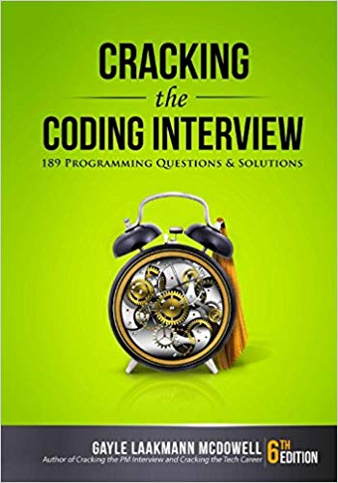



Resources
Notes:
CTCI: helps with approaches to problems
Leetcode: examples of real problems that have been in interviews
Pramp: thousands of professionals practicing live mock interviews & interview questions online, with peers, for free. We help you prep & land your dream tech job.

